Slide 1
Managing Social Responsibility and Ethics
28-01-2026
Jyoti

Slide 2
Should Organizations Be Socially Involved?
Notes:
Another way to view social involvement and economic performance is by looking at socially responsible investing (SRI) funds, which provide a way for individual investors to support socially responsible companies. Typically, these funds use some type of social screening; that is, they apply social and environmental criteria to investment decisions.
SRI funds usually will not invest in companies involved in liquor, gambling, tobacco, nuclear power weapons, price fixing, fraud, or in companies that have poor product safety, employee relations, and environmental track records

Slide 3
From Obligations to
Responsiveness to Responsibility
Classical view: the view that management’s only social responsibility is to maximize profits (advocated by economist and Nobel laureate Milton Friedman).
Social obligation: when a firm engages in social actions because of its obligation to meet certain economic and legal responsibilities.
Notes:
The concept of social responsibility has been described in different ways. For instance, it’s been called “profit making only,” “going beyond profit making,” “any discretionary corporate activity intended to further social welfare,” and “improving social or environmental conditions.” We can understand it better if we first compare it to two similar concepts: social obligation and social responsiveness. Social obligation is when a firm engages in social actions because of its obligation to meet certain economic and legal responsibilities. The organization does what it’s obligated to do and nothing more. This idea reflects the classical view of social responsibility, which says that management’s only social responsibility is to maximize profits. The most outspoken advocate of this approach is economist and Nobel laureate Milton Friedman. He argued that managers’ primary responsibility is to operate the business in the best interests of the stockholders, whose primary concerns are financial.

Slide 4
The Socioeconomic View
Socioeconomic view: when a firm engages in social actions beyond its obligation to meet certain economic and legal responsibilities.
Social responsiveness: engages in social actions in response to some popular social needs.
Social responsibility: A business’s intention, beyond its legal and economic obligations, to do the right things and act in ways that are good for society.
Notes:
The other two concepts—social responsiveness and social responsibility—reflect the socioeconomic view, which says that managers’ social responsibilities go beyond making profits to include protecting and improving society’s welfare. This view is based on the belief that corporations are not independent entities responsible only to stockholders, but have an obligation to the larger society. Organizations around the world have embraced this view as shown by a survey of global executives in which 84 percent said that companies must balance obligations to shareholders with obligations to the public good.
Social responsiveness is when a company engages in social actions in response to some popular social need. Managers are guided by social norms and values and make practical, market-oriented decisions about their actions. For instance, Ford Motor Company became the first automaker to endorse a federal ban on sending text messages while driving.
A socially responsible organization goes beyond what it’s obligated to do or chooses to do because of some popular social need and does what it can to help improve society because it’s the right thing to do. We define social responsibility as a business’s intention, beyond its legal and economic obligations, to do the right things and act in ways that are good for society. A socially responsible organization does what is right because it feels it has an ethical responsibility to do so.

Slide 5
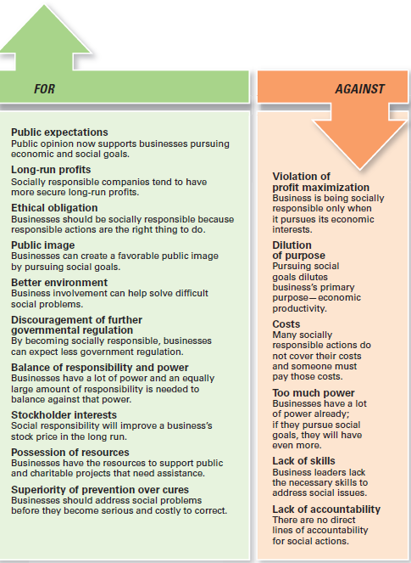
Exhibit 6-1 outlines arguments for and against social involvement
Notes:
Another way to view social involvement and economic performance is by looking at socially responsible investing (SRI) funds, which provide a way for individual investors to support socially responsible companies. Typically, these funds use some type of social screening; that is, they apply social and environmental criteria to investment decisions.
SRI funds usually will not invest in companies involved in liquor, gambling, tobacco, nuclear power weapons, price fixing, fraud, or in companies that have poor product safety, employee relations, and environmental track records

Slide 6
Green Management and Sustainability

Slide 7
Green Management and Sustainability
Green management: managers consider the impact of their organization on the natural environment.
Notes:
Until the late 1960s, few people (and organizations) paid attention to the environmental consequences of their decisions and actions. However, a number of environmental disasters brought a new spirit of environmentalism to individuals, groups, and organizations. Increasingly, managers have begun to consider the impact of their organization on the natural environment, which we call green management.

Slide 8
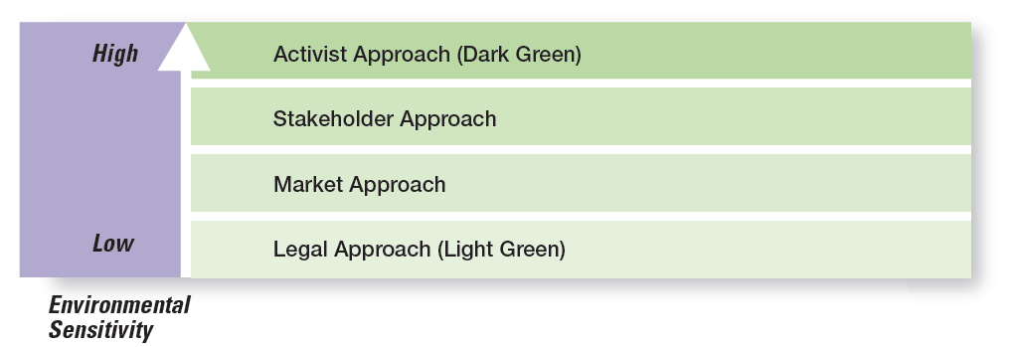
How Organizations Go Green:
Green Approaches

Slide 9
Managers and Ethical Behavior
Ethics: principles, values, and beliefs that define right and wrong behavior
Notes:
What do we mean by ethics? We’re defining it as the principles, values, and beliefs that define right and wrong decisions and behavior. Many decisions managers make require them to consider both the process and who’s affected by the result. To better understand the ethical issues involved in such decisions, let’s look at the factors that determine whether a person acts ethically or unethically.

Slide 10
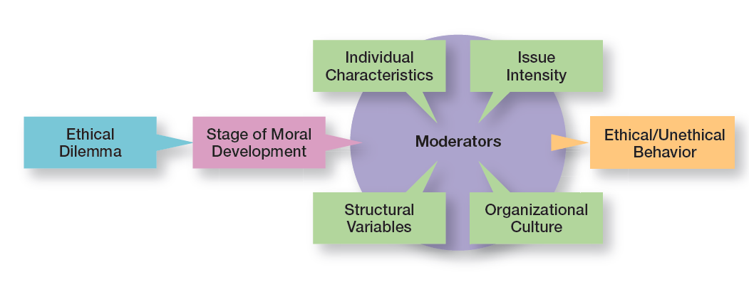
Factors that Determine
Ethical and Unethical Behavior

Slide 11
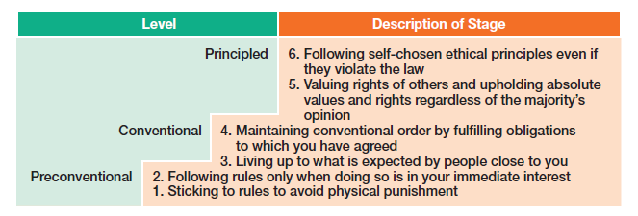
Levels & Stages of Moral Development
Preconventional level
Conventional level
Principled level
Notes:
Research divides moral development into three levels, each having two stages. At each successive stage, an individual’s moral judgment becomes less dependent on outside influences and more internalized.
At the first level, the preconventional level, a person’s choice between right or wrong is based on personal consequences from outside sources, such as physical punishment, reward, or exchange of favors.
At the second level, the conventional level, ethical decisions rely on maintaining expected standards and living up to the expectations of others.
At the principled level, individuals define moral values apart from the authority of the groups to which they belong or society in general.

Slide 12
Individual Characteristics
Values: defines what is wrong or rights
Personality:
Ego strength: Strength of conviction
Locus of control: Internal Locus of control & External Locus of control
Notes:
Two individual characteristics—values and personality—play a role in determining whether a person behaves ethically. Each person comes to an organization with a relatively entrenched set of personal values, which represent basic convictions about what is right and wrong. Our values develop from a young age based on what we see and hear from parents, teachers, friends, and others.
Two personality variables have been found to influence an individual’s actions according to his or her beliefs about what is right or wrong: ego strength and locus of control. Ego strength measures the strength of a person’s convictions. People with high ego strength are likely to resist impulses to act unethically and instead follow their convictions. Locus of control is the degree to which people believe they control their own fate. People with an internal locus of control believe they control their own destinies. They’re more likely to take responsibility for consequences and rely on their own internal standards of right and wrong to guide their behavior.

Slide 13
Structural Variables
Ethical behavior can be influenced by an organization’s structural design:
  Goals
  Performance appraisal system
  Reward allocation
Notes:
Those structures that minimize ambiguity and uncertainty with formal rules and regulations and those that continuously remind employees of what is ethical are more likely to encourage ethical behavior.
Although many organizations use goals to guide and motivate employees, those goals can create some unexpected problems. One study found that people who don’t reach set goals are more likely to engage in unethical behavior, even if they do or don’t have economic incentives to do so
An organization’s performance appraisal system can also influence ethical behavior. Some systems focus exclusively on outcomes, while others evaluate means as well as ends. When employees are evaluated only on outcomes, they may be pressured to do whatever is necessary to look good on the outcomes and not be concerned with how they got those results.
The more that rewards or punishment depend on specific goal outcomes, the more employees are pressured to do whatever they must to reach those goals—perhaps to the point of compromising their ethical standards.

Slide 14
Organization’s Culture
Organization’s culture consists of the shared organizational values.
Values-based management: the organization’s values guide employees in the way they do their jobs
Notes:
The selection process (interviews, tests, background checks, and so forth) should be viewed as an opportunity to learn about an individual’s level of moral development, personal values, ego strength, and locus of control.
Because shared values can be powerful influences, many organizations are using values-based management, in which the organization’s values guide employees in the way they do their jobs.
A strong culture exerts more influence on employees than does a weak one. If a culture is strong and supports high ethical standards, it has a powerful and positive influence on the decision to act ethically or unethically.

Slide 15
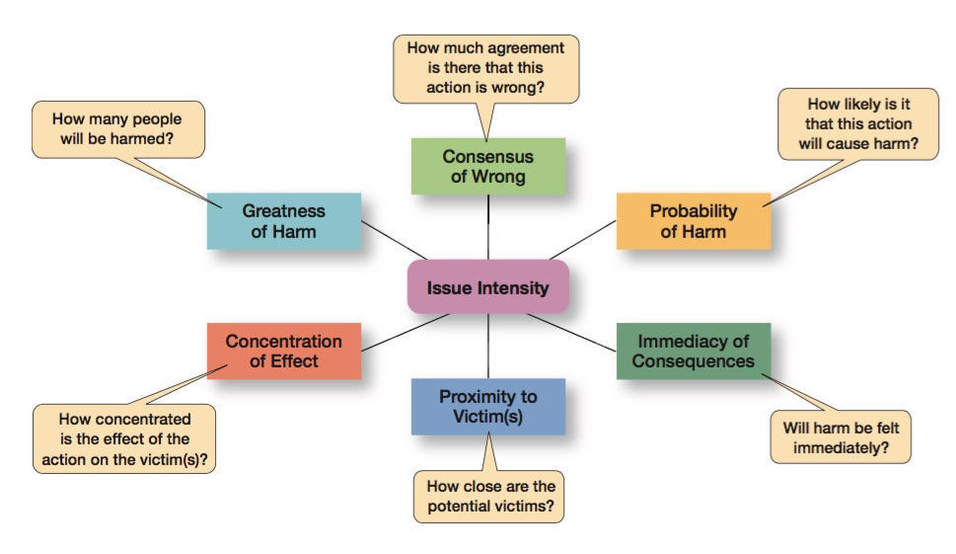
Issue Intensity

Slide 16
Encouraging Ethical behaviour
Employee Selection
Code of ethics: a formal statement of an organization’s primary values and the ethical rules it expects its employees to follow
Leadership at the Top (Ethical leadership)
Ethics Training: seminars, workshops, and training programs to encourage ethical behavior.
Protection of Employees Who Raise Ethical Issues: Whistle-blower (individual who raises ethical concerns or issues to others)
Notes:
Uncertainty about what is and is not ethical can be a problem for employees. A code of ethics, a formal statement of an organization’s values and the ethical rules it expects employees to follow, is a popular choice for reducing that ambiguity. Research shows that 97 percent of organizations with more than 10,000 employees have a written code of ethics.

Slide 17
Thank you

